Slide 1
Deciding the Saywards 2026 Holiday House

Slide 2
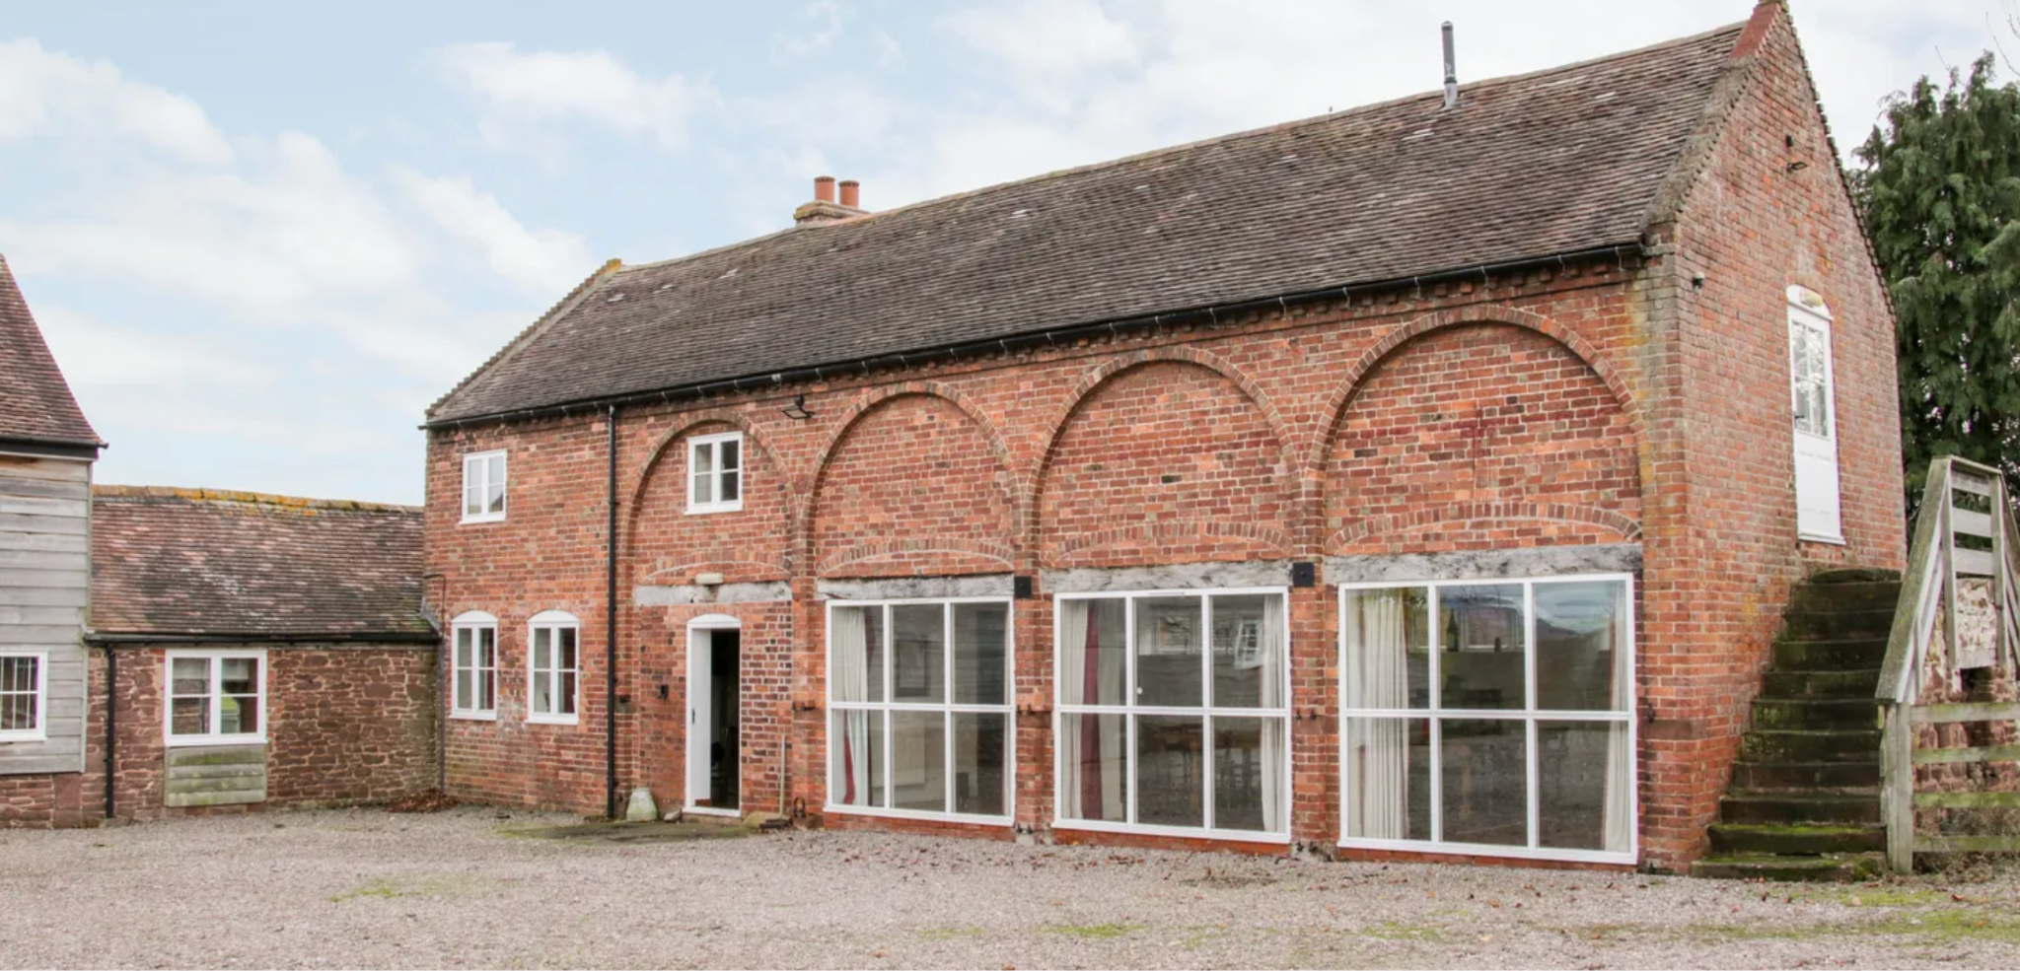
Holiday cottage 1
Location: Shrewsbury, Shropshire
Price: £3020 13-20 June
Bedrooms: 7
Other facilities: Games room
Highlights: Spacious, ensuite rooms, cot/highchair, enclosed garden, peaceful setting, good for dogs.
Drawbacks: Rough access track, remote location, weak WiFi, some cold areas, some baby-proofing needed.
AOB: This house is on the same estate as the one we stayed in for Dan and Mum’s birthday trip.

Slide 3
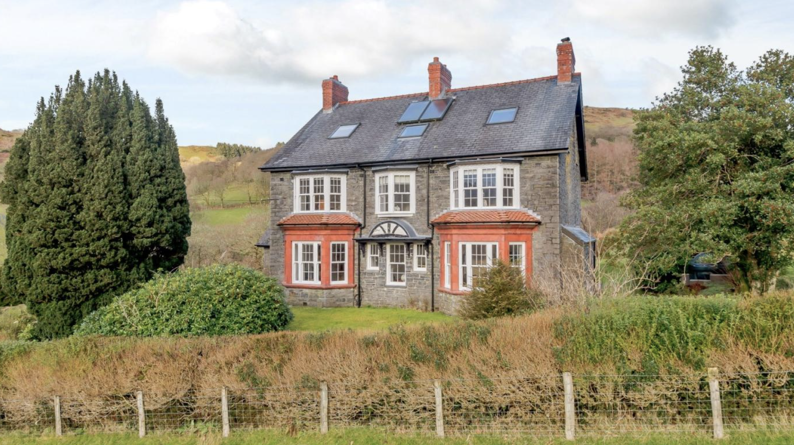
Holiday cottage 2
Location: Aberllefenni, near Corris, North Wales
Price: £2241 12-19 June
Bedrooms: 7
Other facilities:
Highlights: plenty of space, dog-friendly setting, baby-friendly features (highchair, family-friendly rooms) and beautiful surroundings
Drawbacks: Does not state it has an enclosed garden, fairly remote

Slide 4
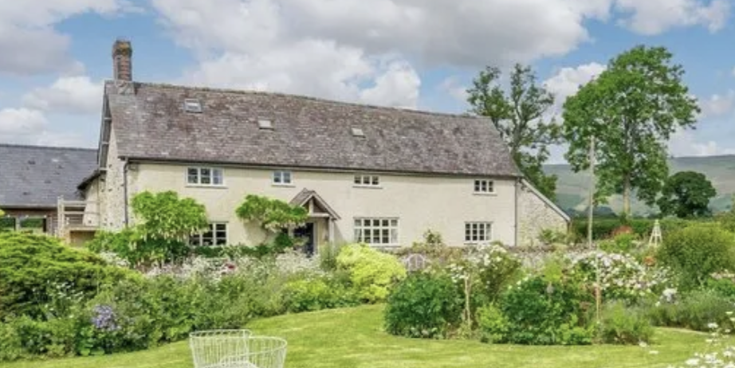
Holiday cottage 3
Location: Walton, Powys, Wales
Price: £3129, 12-19 June
Bedrooms: 6
Other facilities: Ping pong table, EV charger
Highlights: light and airey converted barn,
Drawbacks: Some of the bedrooms have low ceilings, not many bathrooms, no confirmation if the garden is enclosed
AOB: Unable to find any reviews

Slide 5
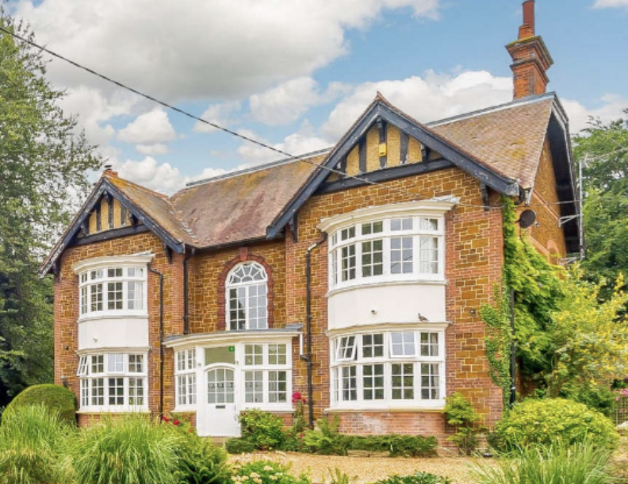
Holiday cottage 4
Location: Snettisham, Norfolk
Price: ??
Bedrooms: 7
Other facilities: Hot tube, outdoor seating
Highlights: Large modern kitchen, internally house is modern and well presented
Drawbacks: Not sure if it is still available, site crashed when I try to check availability

Slide 6
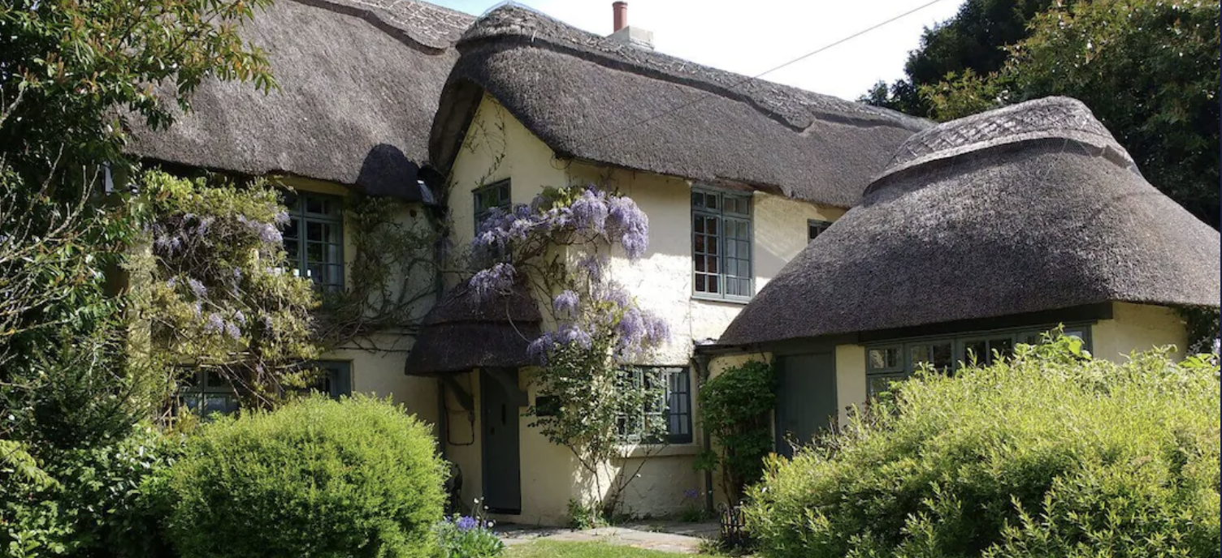
Holiday cottage 5
Location: Wood Green, New Forest
Price: £4387
Bedrooms: 7
Other facilities: Hot tub (for an additional £400), EV charging, games room
Highlights: Village shop within walking distance, mature enclosed garden
Drawbacks: One of the bedroom is in a hut in the garden, charging extra for hot tub

Slide 7
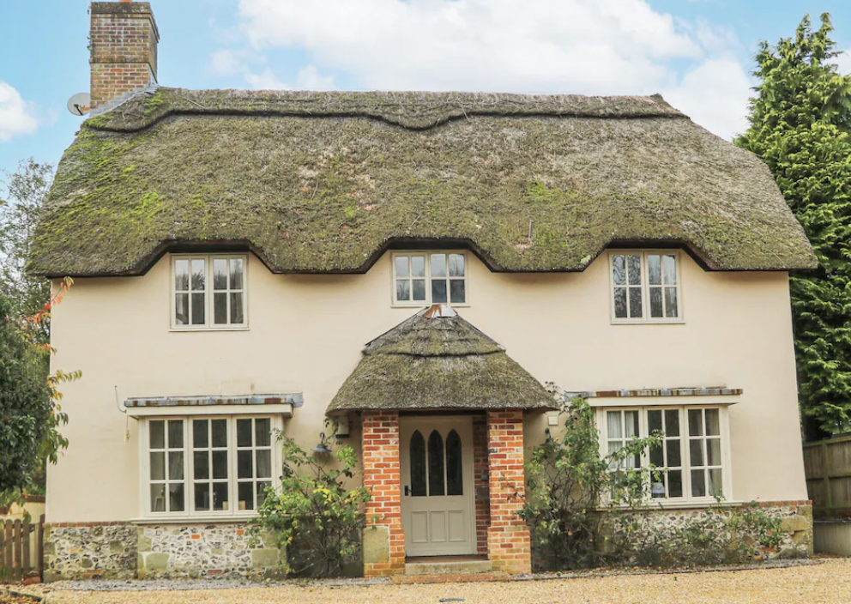
Holiday cottage 6
Location: Sixpenny Handley
Price: £4553
Bedrooms: 8
Other facilities:
Highlights: Everyone gets a king sized bed, garden is enclosed
Drawbacks: Shared areas are not the biggest
AOB: Unable to find reviews

Slide 8
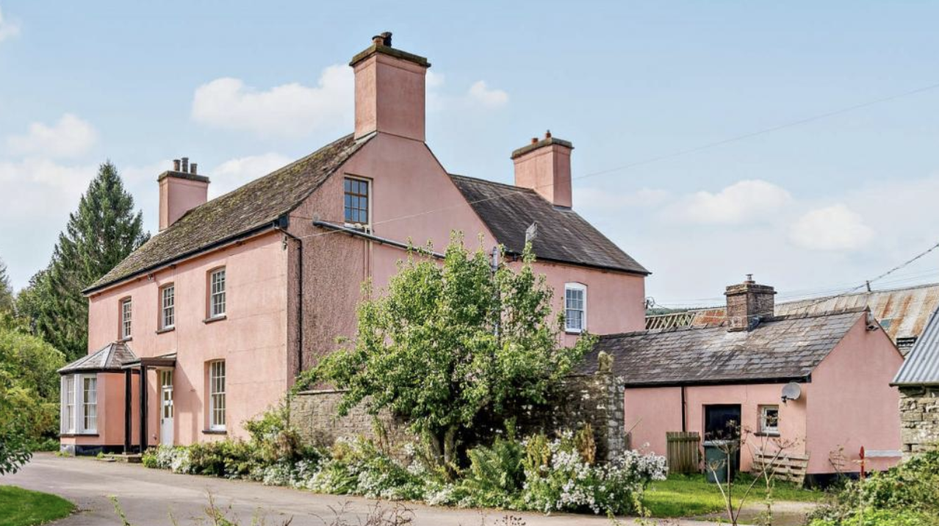
Holiday cottage 7
Location: Talybont-On-Usk, Mid Wales
Price: £2275
Bedrooms: 7
Other facilities: Large garden with a pond nearby
Highlights: Multiple shared spaces, large garden
Drawbacks: Claims to have a well stocked kitchen but there are no pictures (also potentially no dishwasher)
AOB: No info on amount of parking

Slide 9
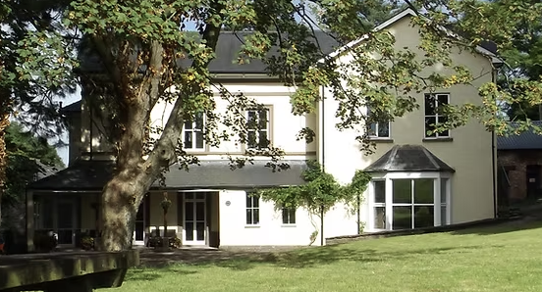
Holiday cottage 8
Location: Brecon Beacons
Price: £3500, 15-22 June
Bedrooms: 9
Other facilities: Games barn
Highlights: 2 acres of gardens, multiple shared rooms
Drawbacks: Minimal pictures so cannot assess most rooms
AOB: 2 houses combined so there are 2 kitchens/2 sitting rooms etc.

Slide 10
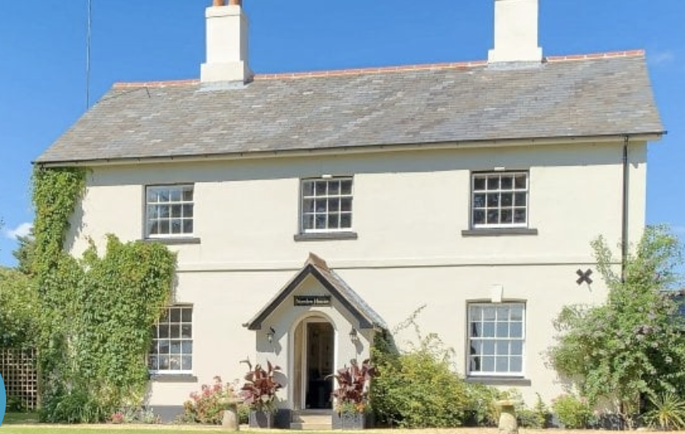
Holiday cottage 9
Location: Corfe Castle, Dorset
Price: £2850 3-10 July (Not available in June)
Bedrooms: 7
Other facilities: Cabin with fireplace
Highlights: Interia is modern and well presented, majority of bedrooms have ensuite
Drawbacks: House is semi detached, 2 separate tables in the dining room,
AOB: Part of a farm complex with an additional holiday cottage and camping ground

